Slide 1
Diabetes prediction with Machine learning
AKSHITA CHOUDHURY
DOMAIN : DATA SCIENCE INTERN

Slide 2
DIABetes and its types
Diabetes is a condition that impairs the body’s ability to process blood glucose, otherwise known as blood sugar. There are several types of diabetes, which have various treatments.
Without ongoing, careful management, diabetes can lead to a buildup of sugars in the blood, which can increase the risk of dangerous complications, including stroke and heart disease
Different kinds of diabetes can occur, and how people manage the condition depends on the type. Not all forms of diabetes stem from a person being overweight or leading an inactive lifestyle. Some are present from childhood
The most common type of diabetes include:
Type 1 - Blood glucose(sugar) level is too high because your body can’t make insulin.
Type 2 - Body doesn’t use insulin properly. Body is resistant to insulin
Gestational Diabetes - Body is unable to make enough insulin during pregnancy

Slide 3
Diabetes Infographics
74
MILLION
Indians diagnosed in 2021
1 out of 10 adults worldwide diagnosed
1 out of 5 are undiagnosed

Slide 4
Diabetes Risk factors
RISK FACTORS FOR TYPE 2 DIABETES
bad diet
OBESITY
frequent spikes in blood sugar levels (hyperglycemia), which can increase the risk of diabetes-related complications
Insulin resistance with impairment of β-cell function leads to the development of diabetes.
75%
60%
inactivity
OVERWEIGHT
The excessive free fatty acid released by adipose tissue leads to a decrease in insulin sensitivity
Excess body fat can contribute to the development of biomedical risk factors, raising levels of blood pressure and abnormal blood lipids
50%
25%

Slide 5

SYMPTOMS OF DIABETES
vision
Weight
Symptoms of blurry vision
Weight loss of more than 5 lbs
50%
33%
injury
kidney
Poor blood circulation leading to slow healing
High blood sugar from diabetes can damage blood vessels in the kidneys as well as nephrons so they don't work as well as they should.
30%
30%

Slide 6
Diabetes prevention
PREVENT TYPE 2 DIABETES
PHYSICALLY ACTIVE
HEALTHIER DIET
GET PLENTY OF FIBER
QUIT SMOKING

Slide 7
Installing Libraries
Importing Dataset
Oversampling Data
EDA
Feature Engineering
Implementing ML Models
PREDICTING UNSEEN DATA

Slide 8
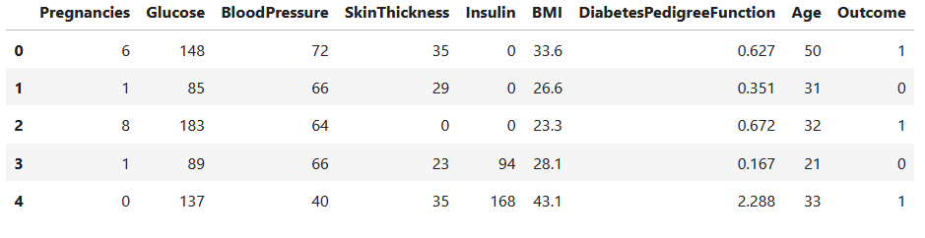
Diabetes Prediction DATA set
PIMA INDIAN DIABETES DATASET - NATIONAL INSTITUTE OF DIABETES AND DIGESTIVE AND KIDNEY DISEASES

Slide 9
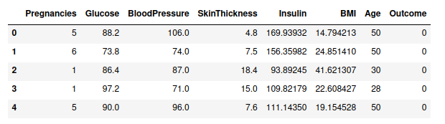
Diabetes Prediction DATA set II
RTML Dataset for Diabetes-Prediction-Using-Machine-Learning

Slide 10
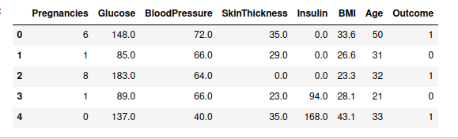
Diabetes Prediction MERGING
Merging the two data set after dropping column(s)

Slide 11
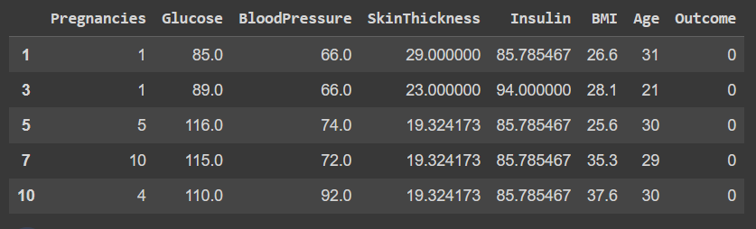
Upsampling DATASET
Upampling dataset to remove Outcome imbalance

Slide 12
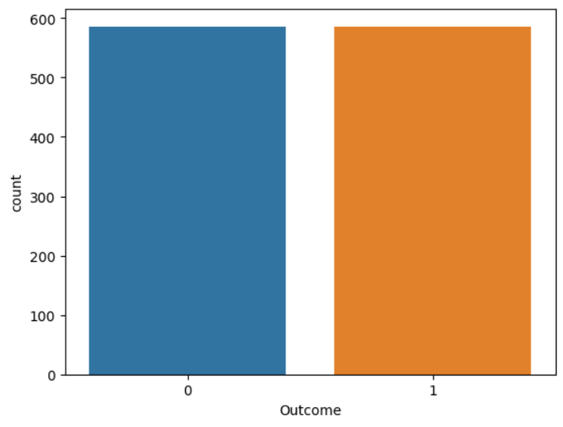
BINARY
OUTCOME

Slide 13
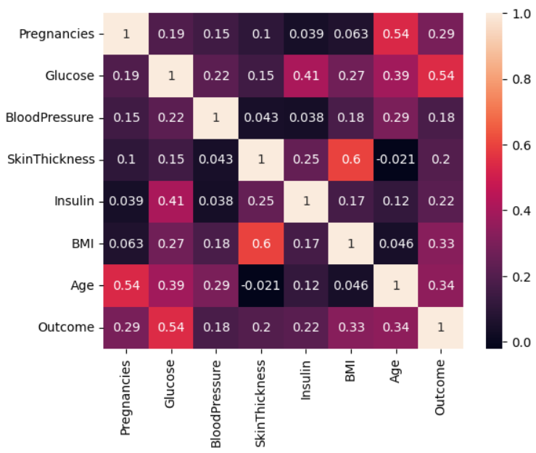
COrrelation
Heatmap
According to the heatmap, we can see correlation between glucose and Outcome is 54%. Hence Outcome has a significant dependance on glucose values

Slide 14
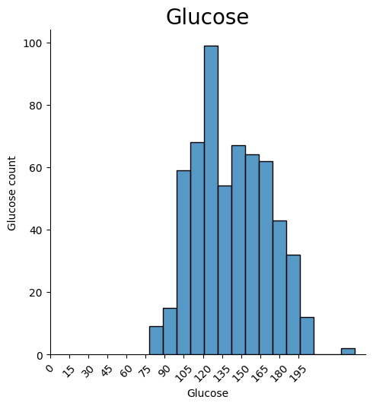
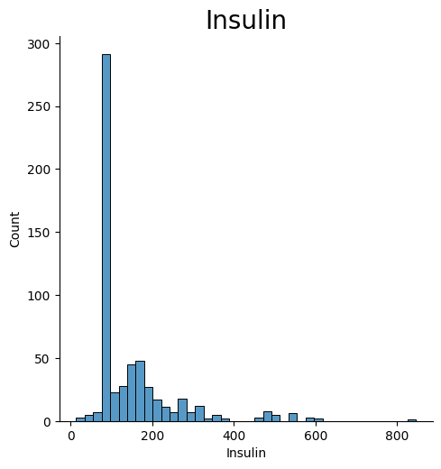
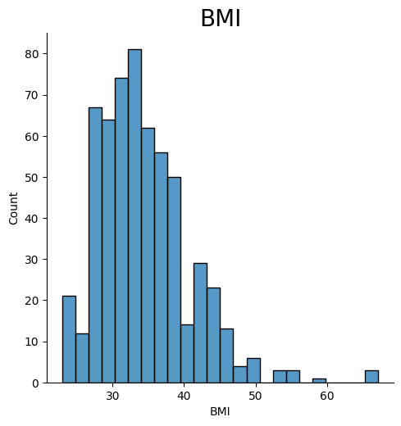
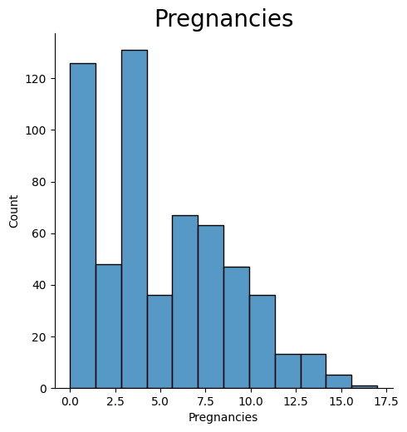
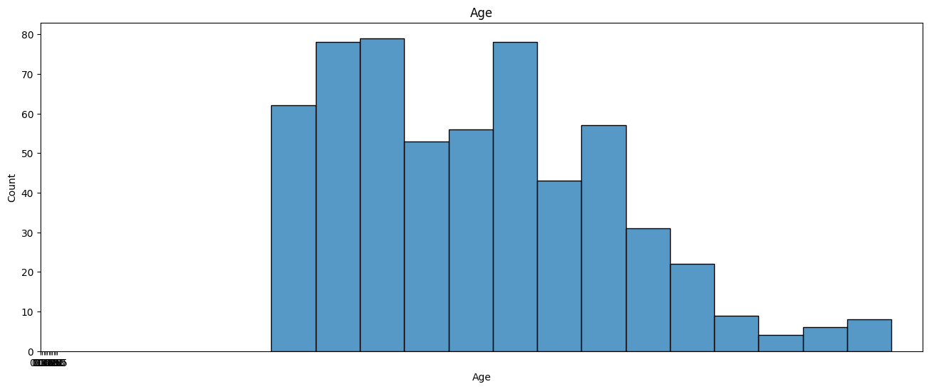
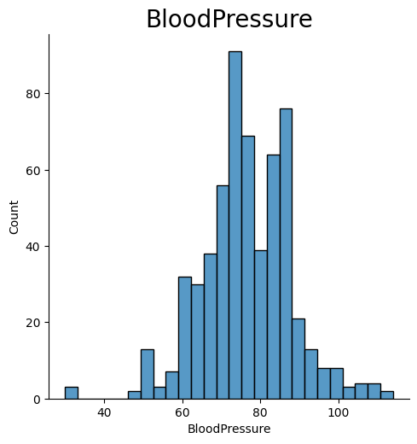

Slide 15

TEST TRAIN SPLIT
70% TRAINING DATA | 30% TESTING DATA
71%
SVM ALGO
77%
KNN ALGO
Support Vector Machine Algorithm
K nearest Algorithm with K value as 25
89%
RANDOM F
75%
NAIVE BIAS
Random Forest Algorithm
Naive Bias Algorithm

Slide 16
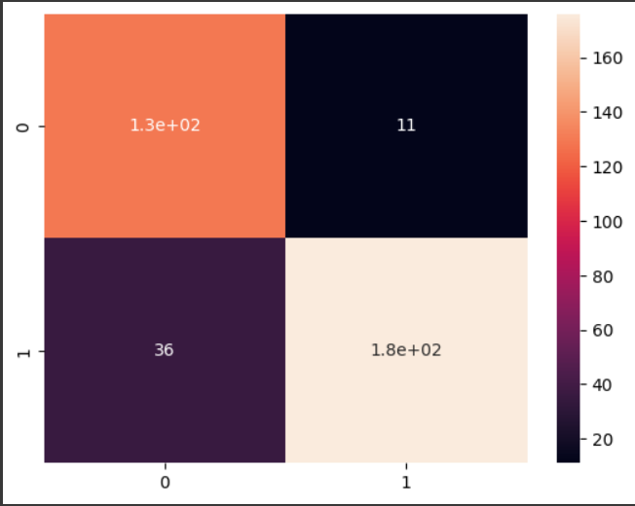
COrrelation
Heatmap
RANDOM FOREST
0,0 means true negative and 1,1 means true positive and 0,1 means even person is negative but showing result positive and 1,0 means person is positive but shows negative

Slide 17
STAY HEALTHY
STAY SAFE
THANK YOU
AKSHITA CHOUDHURY
DOMAIN : DATA SCIENCE INTERN

